Slide 1
SPLITWISE APP
Submitted to:- Submitted by:-
Mr. S.K. Ansari Vrinda Puri (2210992549)
Yankit Kumar (2210992552)
Akshit Kansal (2210990092)
Swastik Garg (2210992432)

Slide 2
Table of Contents
Introduction
Problem Statement
Technical Details
Key Features
Project Highlights
Conclusion
References/Links used

Slide 3
Introduction
Splitwise is a widely-used expense-sharing application that streamlines the process of managing shared expenses within groups. Developed using React, the app offers a user-friendly interface and a range of features to simplify financial coordination among friends, roommates, or colleagues. Users begin by signing up or logging in, accessing a personalized dashboard displaying summaries of current balances and recent transactions.
Within the app, they can create groups, adding members and categorizing shared expenses. Each expense is meticulously tracked, with users inputting details such as amount, description, and participants. Utilizing React's dynamic capabilities, the app ensures equitable expense distribution among group members, either through manual input or automated algorithms. Notifications alert users to updates in their balances or new expenses. Additionally, the app facilitates debt settlement, allowing users to record payments or transfers between individuals, thus maintaining accurate financial records.
Employing responsive design principles, the Splitwise React app delivers a seamless experience across various devices. Backend data management, facilitated by databases like Firebase Realtime Database, ensures efficient storage and retrieval of user information, group data, and transaction history. Through thorough testing and deployment on hosting platforms like Firebase Hosting, the Splitwise app guarantees reliability and accessibility to users, enhancing their ability to manage shared expenses effortlessly.

Slide 4
Problem Statement
In today's interconnected world, people often share expenses with friends, family, or colleagues for various activities such as group outings, vacations, household bills, or shared living expenses. However, managing these shared expenses efficiently can become a daunting task, leading to confusion, misunderstandings, and even strained relationships.
Existing methods of splitting expenses, such as manual calculations or spreadsheets, are time-consuming, error-prone, and lack transparency. Participants may forget who paid for what, how much they owe or are owed, and resolving these discrepancies can be challenging.
To address these issues, we propose the development of a digital solution called Splitwise. Splitwise is an intuitive and user-friendly expense-sharing application designed to streamline the process of managing shared expenses among groups of people.

Slide 5
Technical Details
HTML: The HTML document is structured using standard HTML tags.The document has two <head> sections. The first section includes meta tags for character set, compatibility, and viewport settings. It also includes a title tag and a link tag to an external CSS file.
CSS:The CSS styles are defined within <style> tags in the <head> section. The * selector sets the font family to 'poppins' and the text colour to black for all elements in the document.
JavaScript: The JavaScript code snippet provided seems to be incomplete as it is missing the opening and closing <script> tags.The code adds an event listener to the form's submit event using the add Event Listener method.When the form is submitted, it prevents the default form submission behaviour using event.preventDefault().

Slide 6
REACT: React is a JavaScript library known for its component-based architecture and virtual DOM. It offers JSX syntax for writing UI components, enabling a more intuitive development experience.

Slide 7
Key Features
The structure of the website has many different features provided for better communication and easy interaction. Some of them are listed below:
Mobile Responsiveness-A mobile-responsive feature of our travel agency website ensures:
•Increased visibility and higher ranks on search engines
•A better user experience
•Increased conversion rates

Slide 8
Expense Tracking and Splitting: Splitwise allows users to easily add expenses and split them among group members. It supports various splitting options such as equal splitting, percentage-based splitting, and custom amounts. This is especially useful for roommates, group trips, or any situation where costs need to be shared among multiple people.
Debt Simplification and Settlement: The app keeps a running total of who owes whom, and can simplify debts by minimizing the number of transactions needed to settle up.

Slide 9

Project Highlights
Home Page

Slide 10


Slide 11
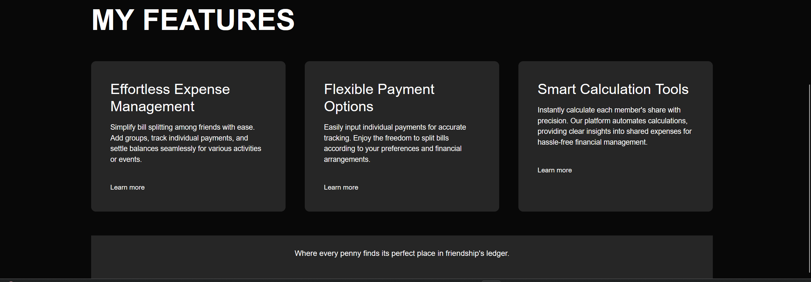

Slide 12


Slide 13
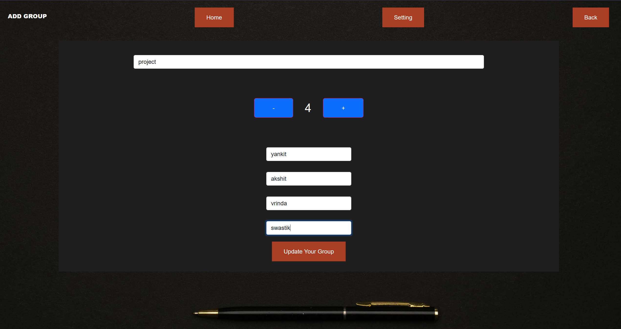

Slide 14
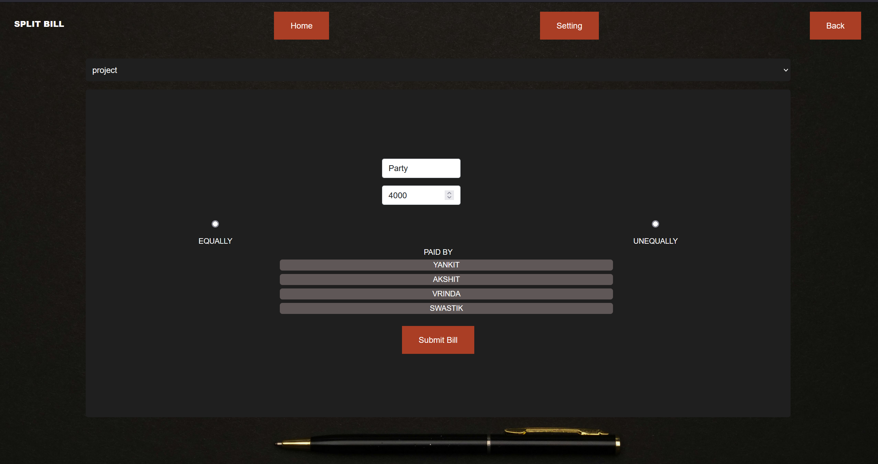

Slide 15
Conclusion
Building a Splitwise-like application with React empowers developers to create a feature-rich platform that simplifies expense tracking and sharing among users. React's component-based architecture encourages modular development, facilitating the creation of reusable components for managing expenses, groups, and user interactions. By leveraging React's state management capabilities, developers can dynamically update the UI in response to user actions, ensuring a fluid and responsive user experience. React's routing capabilities enable the creation of a multi-page application structure, allowing users to seamlessly navigate between different sections of the application.
Integrating with backend services enables developers to store and retrieve user data securely, ensuring data integrity and privacy. Implementing user authentication mechanisms ensures that only authorized users can access sensitive information and perform actions such as adding expenses or joining groups. Real-time updates using technologies like WebSockets enhance collaboration by instantly reflecting changes made by other users, providing a synchronized experience across devices.

Slide 16
References
https://github.com/login
https://www.w3schools.com
https://en.wikipedia.org/wiki/CSS
https://www.codewithharry.com/videos/css-in-one-video
https://www.codewithharry.com/videos/html-tutorial-for-beginners
https://chat.openai.com/

